Slide 1

Sciter
Present and future.
Details of implementation.
Best practices.

Slide 2
UI, state of affairs
Applications with dynamic UI - whole UI or its parts are getting composed in real time.
Applications have dynamic lifecycle - frequent functionality and UI design updates.
Connected or occasionally connected applications.
UI theming and styling, branding.
Non-trivial user input methods.
Touch interfaces.
Animations.

Slide 3
Really, why Sciter?
Conventional browser engines – security model is not suitable for desktop UI. “Embedability” is quite low.
Existing CSS model – endless “tape” that has width but no height. CSS still does not support vertical-align except of table cells. CSS FlexBox is there but not finalized.
JavaScript is good but not good enough for “serious” applications. No modularity, no classes out of the box. Syntax is not that expressive. “Semicolon injection”…

Slide 4
Ok, Sciter, but why new Sciter?
Better monitors are coming:
Transition of screen resolution from 96 dpi to 300 dpi leads to
9 times increase of memory needed for holding bitmaps and window buffers.
Drawing by CPU and copying of such bitmaps from/to display memory is not an option anymore.
That is why Direct2D in new Sciter.
Animations!

Slide 5
Sciter Architecture
Sciter modules:
HTML DOM
CSS
TIScript
Layout managers.
Animation drivers.

Slide 6
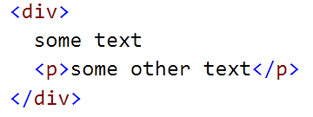

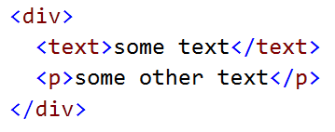
Sciter 1 and Sciter 2/3 differences, DOM
Sciter 1 – uses rendering tree that maps 1:1 to DOM tree.
the <text> (artificial text container) problem:
Sciter 2/3 – uses source DOM tree and maintains parallel rendering tree. DOM tree is a parsing (source) tree.

Slide 7
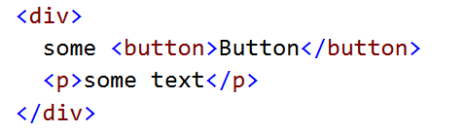
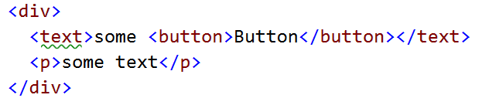

Sciter 1 and Sciter 2 differences, CSS selectors
The only difference - child A > B selectors:
To select the button using child selector:
Sciter 1 - div > text > button
Sciter 2/3 - div > button (or the above)

Slide 8
HTML DOM
List of classes
Node
Text: Node
Comment: Node
Element: Node
Document: Element
View
DOM tree:
View contains single Document element/node.
Document contains tree of its children.

Slide 9
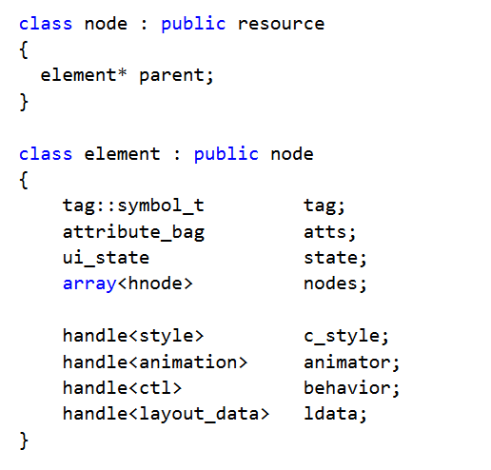
HTML DOM. Node and Element

Slide 10
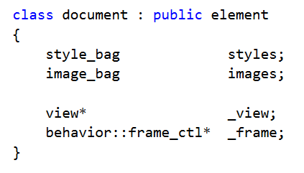
HTML DOM. Document
Document is an element – root of the DOM tree.
Contains resource and style collections:

Slide 11
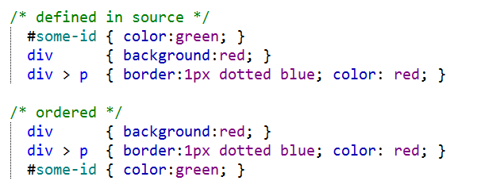
CSS
Architecture:
Flat table of
selector/property-list items
ordered by the selector specificity

Slide 12
CSS. Style resolution. Selectors complexity
To find styles of DOM elements:
Each DOM element is tested against each style selector.
If selector matches style then properties of style rule are applied.
The complexity of style resolution is: O(N*S*D) where:
N – number of DOM elements;
S – number of style rules;
D – depth of the DOM tree;

Slide 13
CSS. Style resolution. Optimization
Engine does sibling style optimization:
Previous sibling with resolved style is tested against “similarity”:
Has same set of attributes and state flags
Has same number of children, etc.
If previous sibling matches then its resolved style is used for the element.
Note: use of :nth-child() selector breaks this optimization.

Slide 14
CSS. Style resolution. Design time optimizations.
Minimize number of CSS rules.
Avoid use of universal selector * (match any).
Define rightmost selector as specific as possible:
ul li.item {…} is better than:
ul .item {…}
Use child selectors:
ul > .item {…} is better than:
ul .item {…}
Use style-set’s where applicable.

Slide 15
Style sets
Style set is an
isolated set of style rules
that is applied to some DOM element and its sub-tree (descendants).
Feature goals:
To bring at least some modularity to CSS
To overcome the style complexity resolution problem - O(N*S*D).

Slide 16
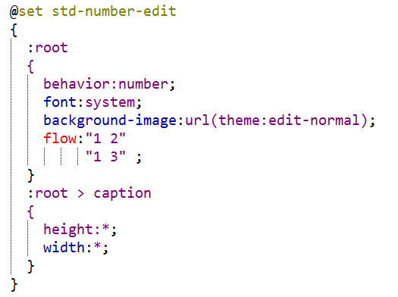
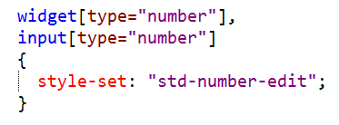
Style sets, declaration
Declaration of the style set:
Applying style set to the element and its sub-tree:

Slide 17
Flow and flex units
HTMLayout/Sciter specific CSS extension.
Introduced to support horizontal and vertical flexible layouts adjustable to different window sizes and screen resolutions.
Standard CSS property display: block | inline-block | table-cell | etc. defines “topology” of elements.
flow: vertical | horizontal | horizontal-flow | “template” | etc. defines exact layout of elements inside a container.

Slide 18
CSS property flow
Defines layout manager used by a container to replace its children, accepts following values:
vertical
horizontal
horizontal-wrap and vertical-wrap
“template”
stack
row(tag1,tag2,…)
column(tag1,tag2, …)

Slide 19

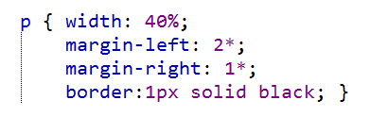
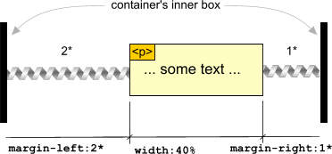
Flex units
Markup:
Style:

Slide 20
CSS: vertical-align & horizontal-align
Alignment is a part of flex computations.
vertical-align CSS property treated as standard when it is defined for display:inline-block elements – defines alignment of the element inside line box.
vertical-align for flex containers is treated as for display:table-cell – defines content alignment of the container.
horizontal-align (sciter specific) defines content alignment of the flex-container in horizontal direction.

Slide 21
flow:vertical |horizontal
Single column | row of block elements
Flexes computed against container box
vertical-align and horizontal-align are in effect.
div.A { height:auto }
div.B { height:* }
div.A { width:auto }
div.B { width:* }

Slide 22
flow:”template”
Allows to define grid layout where elements can span adjacent cells. Similar to table but not exactly.
Defined as list of strings. Each string defines row of “cells”. Cell contains index of child element replaced in the cell.
<section #container>
<div>1</div> <div>2</div>
<div>3</div>
<div>4</div>
</section>
1
2
4
#container
{ flow: “1 2 4” “1 3 3”;
}
3

Slide 23
flow:stack
Motivation: containers with tabs.
Children replaced as deck of cards – one on top of another.
Stack-container intrinsic dimensions – widest/tallest child.
Children rendering order can be defined by z-index of child elements.
Flex computed for each child individually.

Slide 24
Layout computation.
CSS mandates following steps:
Phase I: min/max intrinsic widths. Result: computed width.
Phase II: horizontal layout (text, floats) inside given width. Horizontal flexes computation. Horizontal alignment. Result: computed height.
Phase III: vertical flexes and vertical alignment.

Slide 25
Complexity of layout computation
Most of the time – O(N), N is a number of DOM elements involved.
If overflow: auto is used then complexity is O(t * N) (where t is 1..4) when dimensions are close to intrinsic widths.
Use of Element.intrinsicWidthMin/Max may lead to additional measure/drop-layout/re-measure steps.
Dynamic updates and property animations: small change of the DOM may lead to deep tree layout computation.

Slide 26
Layout complexity, solutions.
Internal optimizations:
Delayed layout computation.
Design time optimizations:
Local layout roots: overflow: hidden | visible + fixed dimensions.
virtual lists and tables. Fixed tables where applicable.
overflow: scroll | scroll-indicator.
avoid use of .width = self.box-border-width() & friends in CSSS!, use static declarations and flexes instead.
Runtime optimizations:
Use of immediate mode drawing (element.paintBackground() and Co.), last resort but effective.
Use of transform: scale(…) where applicable.

Slide 27
Native behaviors
Behavior is a named event handler attached to DOM element.
Behaviors attachment is defined by CSS property “behavior”. Example: all <tb-button> elements inside <div class=container> behave as buttons:
An element may have multiple behaviors assigned.
The behavior property assigns native event handlers that are declared in engine core or in code of host application.
Close analogy: HWND == HELEMENT, behavior == WinProc + struct
Support concept of value.
div.toolbar > tb-button { behavior:button; }

Slide 28
Built-in behaviors
Basic buttons
clickable
button
checkbox
radio & switch
Selects
dropdown-select
dropdown-multi-select
select
select-multiple
select-checkmarks
tree
tree-view
tree-checkmarks
Edits
edit
password
masked-edit
numeric
integer
decimal
textarea
richtext
Date/time
calendar
date
time
Output/indicators
output
text
integer
decimal
currency
date
date-local
time
time-local
progress
scrollbar
slider
HTML behaviors
frame
history
frame-set
form
hyperlink
htmlarea
image
shellicon
filethumbnail
style-bag
Menu
menu-bar
menu
popup-menu
popup-selector
Auxiliary
expandable-list
collapsible-list
swipe
marquee
column-resizer

Slide 29
Scripting behaviors & event handlers
Subclasses:
Aspects:
Event handlers:
class MyButton : Behavior {
function onMouse(event) { … }
function onKey(event) { … }
}
span.my-button {
prototype: MyButton url(buttons.tis);
}
function MyButton() {
this.subscribe(“click”, function() {…});
}
span.my-button {
aspect: MyButton url(buttons.tis);
}
var someEl = …;
someEl.subscribe(“click”, function() {…});

Slide 30
TIScript
Mostly JavaScript, has:
Compiler, produces bytecodes.
Virtual machine executing those bytecodes
Heap manager that uses copying GC.
Extended by:
Classes, namespaces, decorators, persistent storage, streams.
Integrated with DOM, GC.

Slide 31
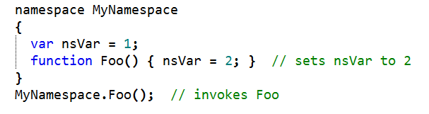
TIScript: namespaces
Namespaces are declared by using the namespace keyword. They can contain classes, functions, variables, and constants:

Slide 32
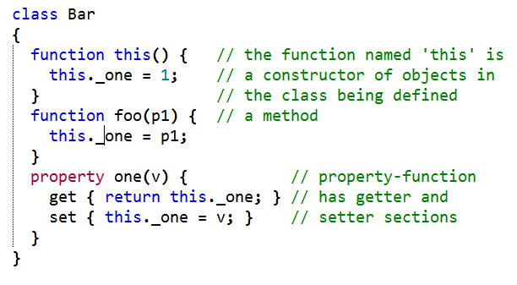

TIScript: Classes, constructors, and properties

Slide 33

TIScript: Lambdas and anonymous functions
Single statement lambda function: ':' [param-list] ':' <statement>;
Lambda function block: ':' [param-list] '{' <statement-list> '}‘
Classic anonymous function: 'function(' [param-list] ')' '{' <statement-list> '}‘

Slide 34

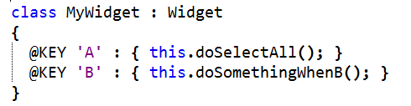
TIScript: Decorators
“metaprogramming” feature

Slide 35
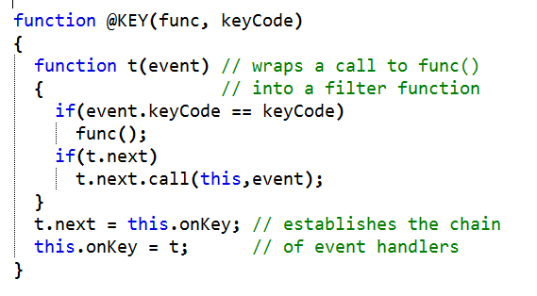
TIScript: Decorator sample
Decorator is a plain function with the name starting from ‘@’:

Slide 36
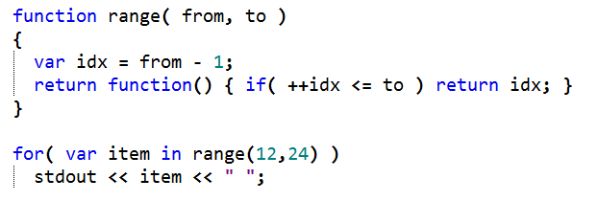
TIScript: iterators
the statement for( var item in func) will call the func and execute the body of the loop with its value on each iteration.

Slide 37
TIScript: types
Numeric: integer, float
Collections: array, map (object)
String and Symbol
Boolean: true and false
Stream (file, socket, in-memory)
Bytes – vector of bytes.
Persistent data: Storage and Index

Slide 38
New Script Painting Model and Graphics
Objects:
Graphics
Graphics.Path
Graphics.Text
Image
Paint events:
element.paintBackground <- func(gfx)
element.paintForeground <- func(gfx)
element.paintContent <- func(gfx)
Request painting:
element.refresh();

